Slide 1
tkinter for Python 3
Jack Tunstall – Eric Rincon
Jonathan Christian – Jordan Lopez
Trey Carlson

Slide 2

What is tkinter?
tkinter is the traditional GUI library for Python.
tkinter was created by Fredrik Lundh in 1999 and is a wrapper around “a complete Tcl interpreter embedded in the Python interpreter.”

Slide 3
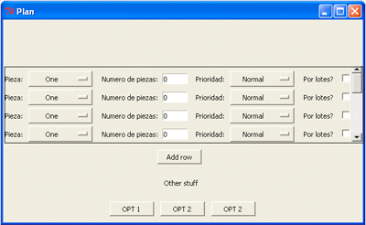
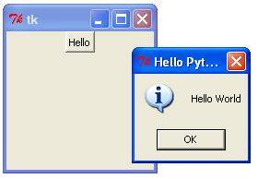
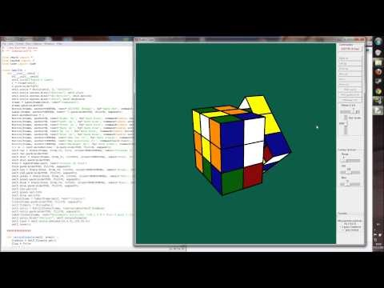
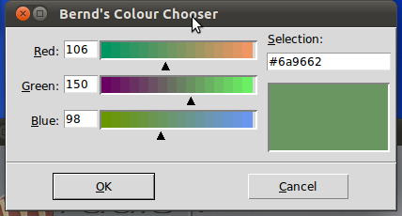
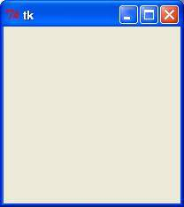
What can you do with tkinter?
If you can imagine it, you can build it*
*If your imagination just includes standard GUI objects
Or you’re this guy

Slide 4
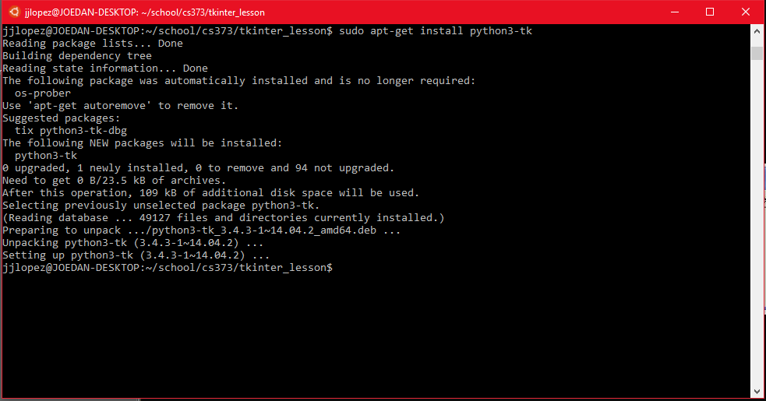
Installation
apt-get install python3-tk

Slide 5
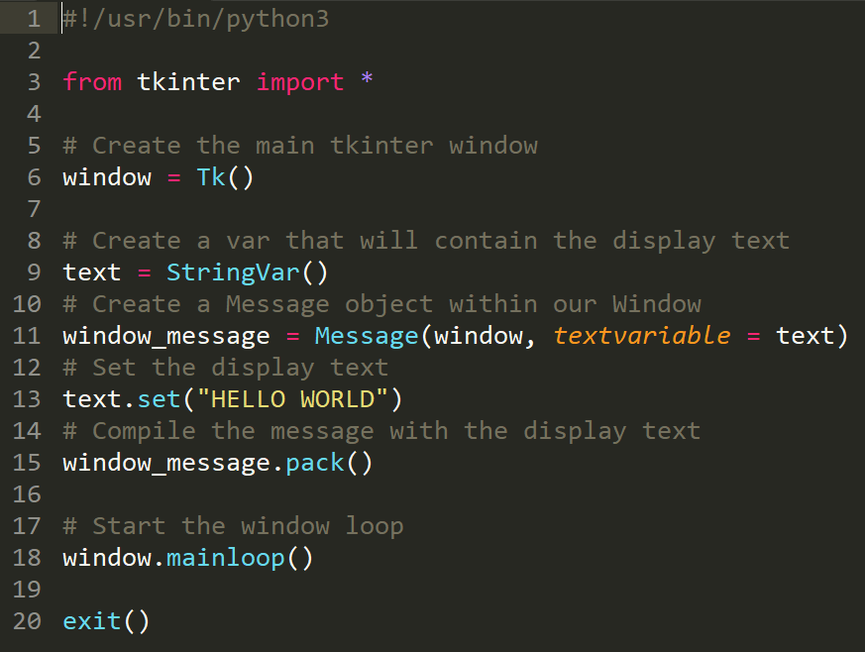
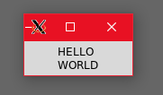
Intro: HELLO WORLD
The “Did I install this correctly” program

Slide 6
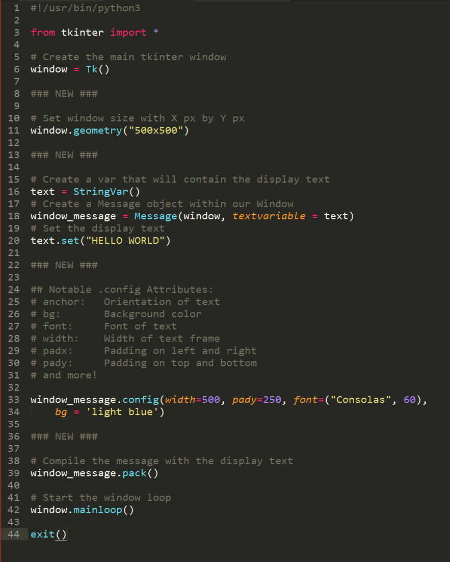
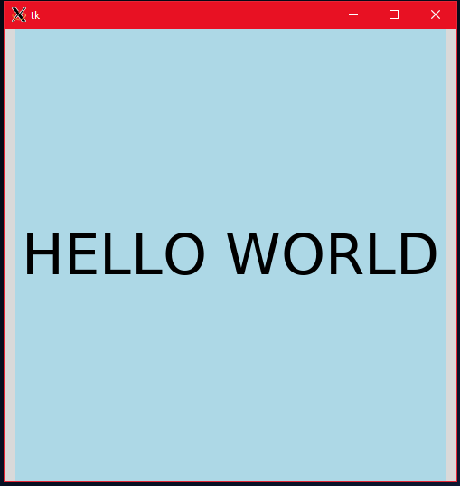
A Bigger, Better HELLO WORLD
What is this, a messagebox for ants?

Slide 7
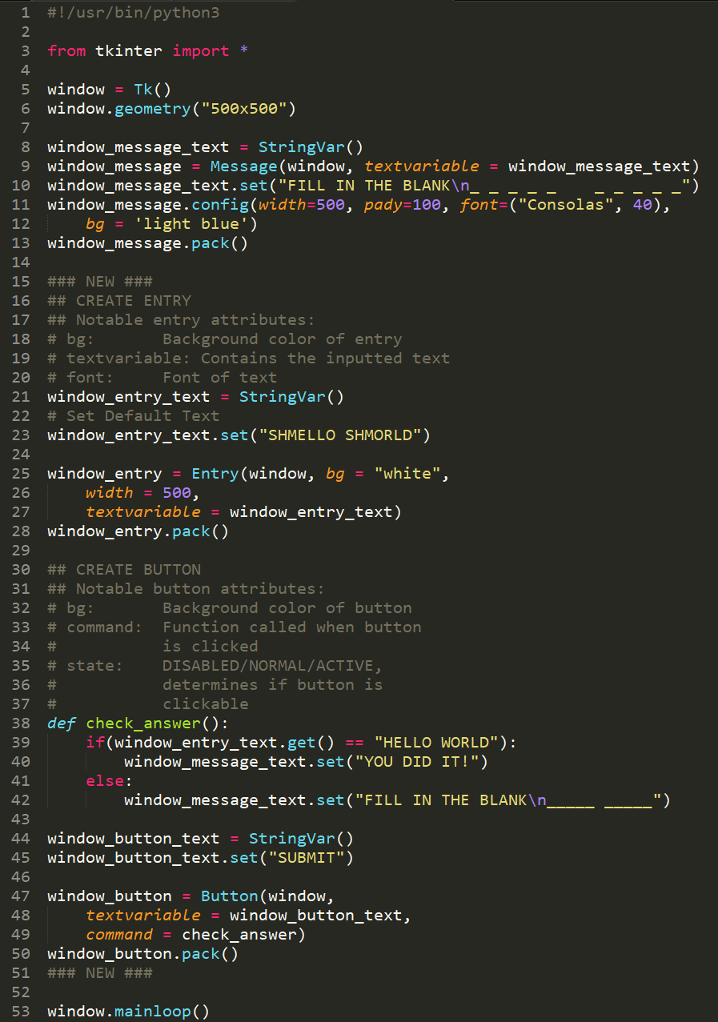
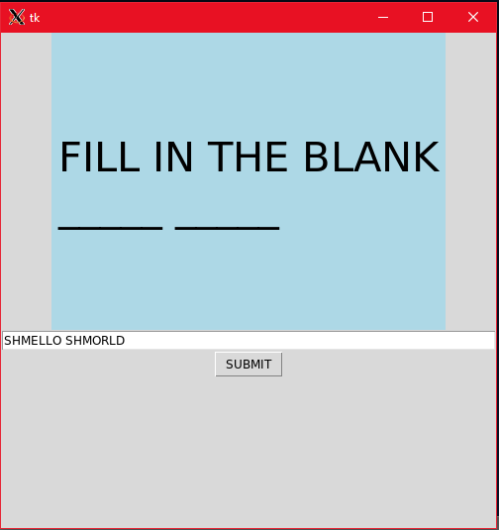
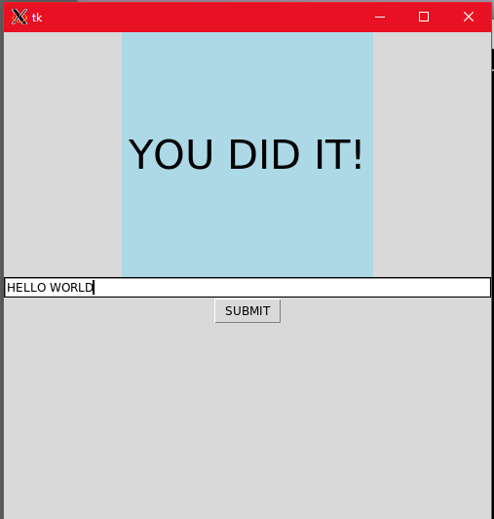
Outsourcing HELLO WORLD
Hey user, do my job for me.

Slide 8
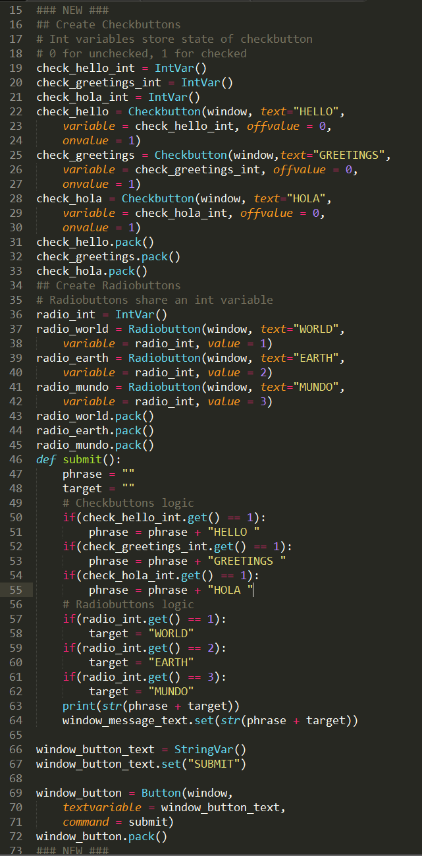
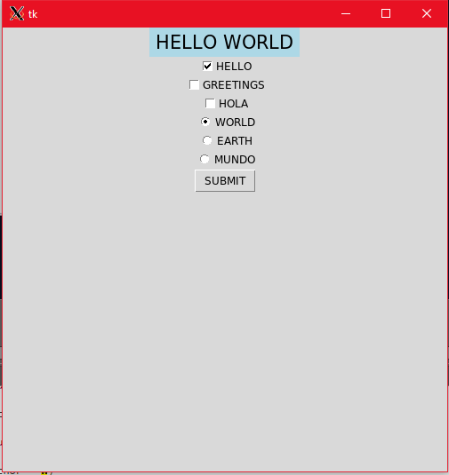
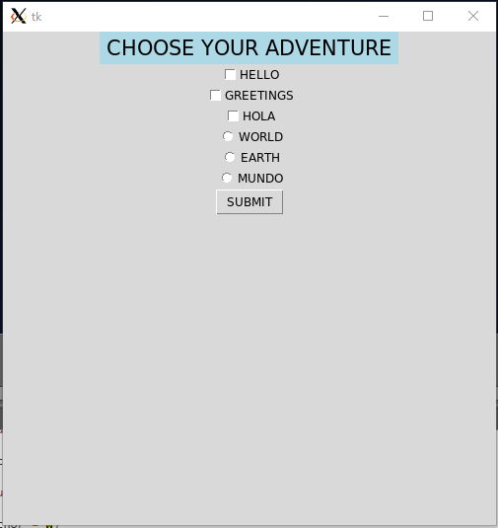
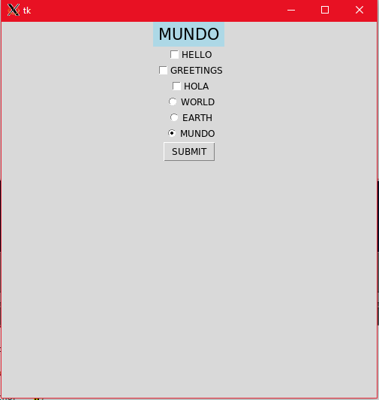
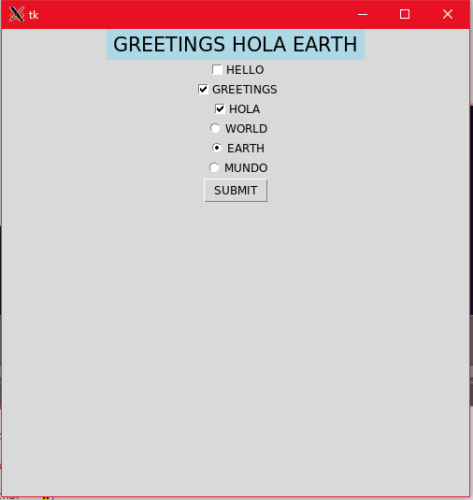
Choice HELLO WORLD
Choose your own adventure

Slide 9
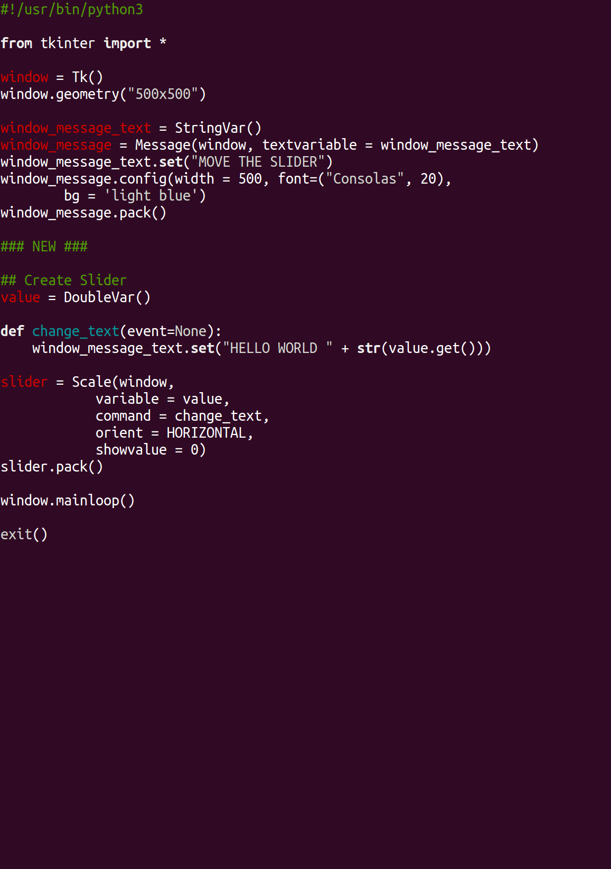
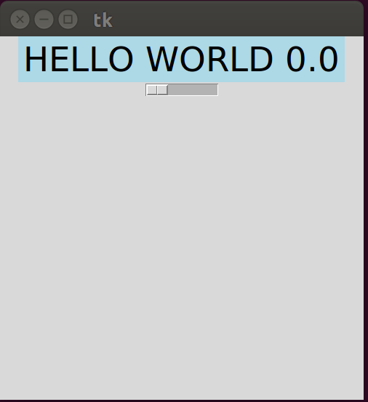
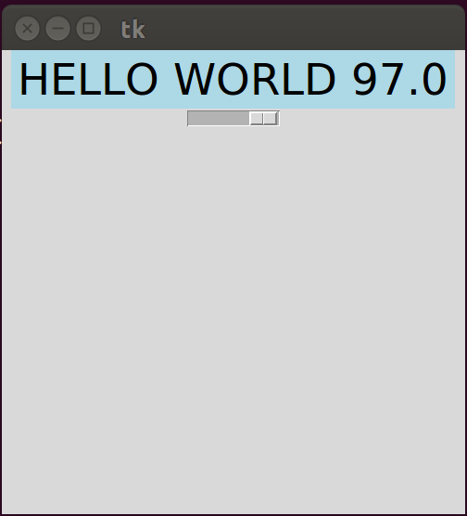
Click and Drag
Adding in sliders

Slide 10
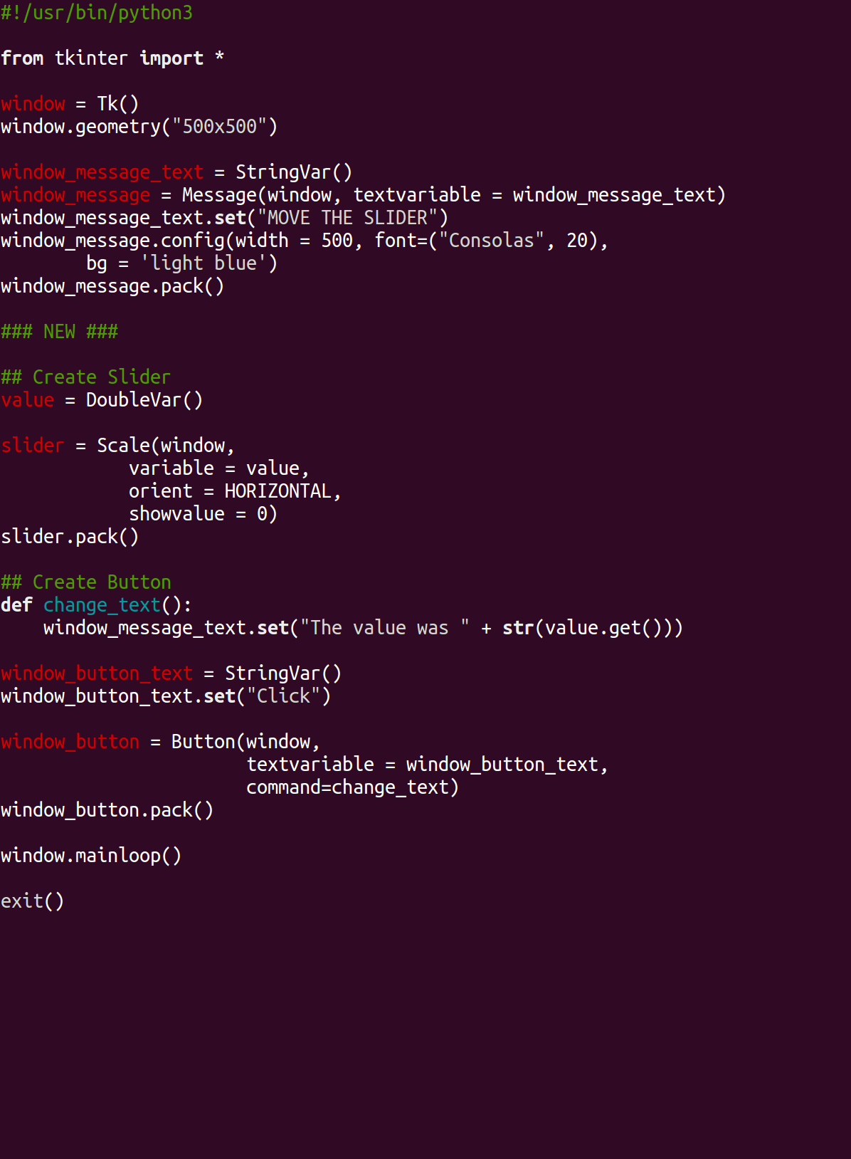
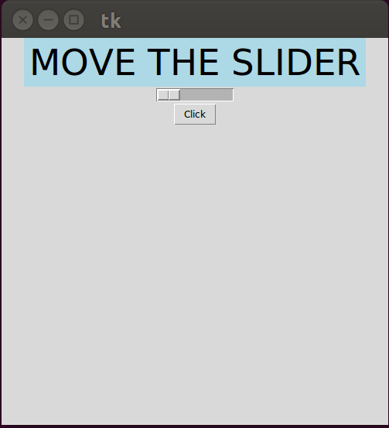
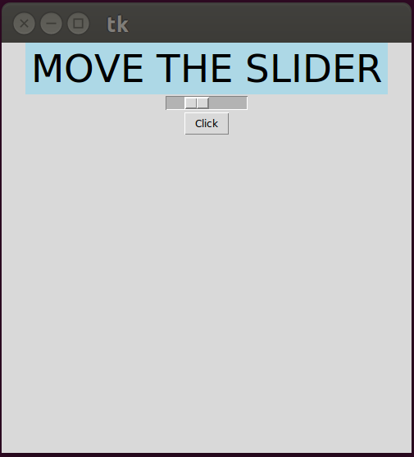
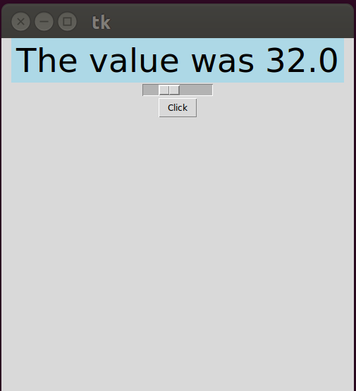
Click and Drag
Now with buttons!

